Slide 1
DOCS: A Domain-Aware Crowdsourcing System Using Knowledge Bases
Yudian Zheng, Guoliang Li, Reynold Cheng
University of Hong Kong, Tsinghua University

Slide 2
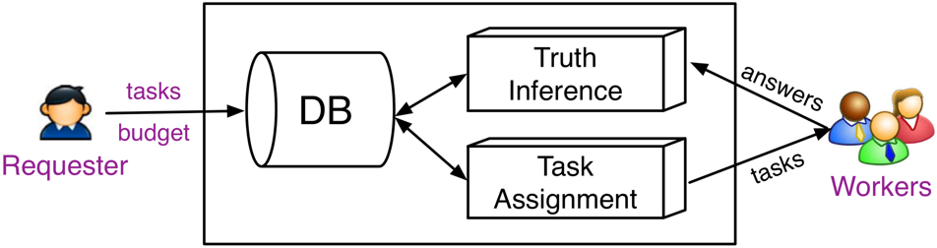
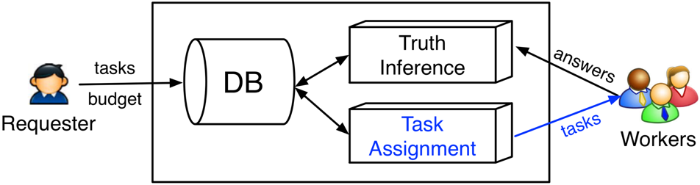
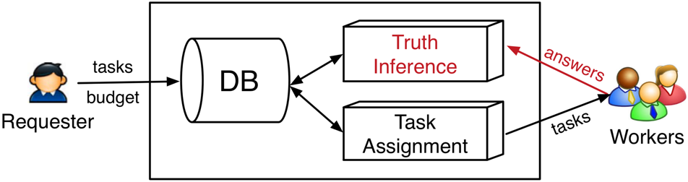
Crowdsourcing Workflow
Requester deploys tasks and budget on crowdsourcing platform (e.g., AMT)
Workers interact with platform (2 phases)
Task Assignment: When a worker comes to the platform, the worker will be assigned to a set of tasks;
Truth Inference: When a worker accomplishes tasks, the platform will collect answers from the worker.

Slide 3
Question Answering Application
Existing Platforms
Examples
Did Michael Jordan win more NBA championships than Kobe Bryant?
Is there a name for the song that FC Barcelona is known for?

Slide 4


Existing Works Fail in QA tasks
Each task is related to different domains
Sports
Politics
Entertainment
Did Michael Jordan win more NBA championships than Kobe Bryant?
Sports
Is there a name for the song that FC Barcelona is known for?
Sports &
Entertainment
Each worker has diverse qualities over domains

Slide 5
Our Solutions
Build domain aware task model
Sports
Politics
Entertainment
Did Michael Jordan win more NBA championships than Kobe Bryant?
Build domain aware worker model
Apply them to truth inference and task assignment

Slide 6
Part I: Domain Aware Task Model (3 steps)
Step 1: Entity linking (map entity to knowledge bases)
Did Michael Jordan win more NBA championships than Kobe Bryant?
W. Shen, J. Wang, and J. Han. Entity linking with a knowledge base: Issues, techniques, and solutions. TKDE, 27(2):443–460, 2015.

Slide 7
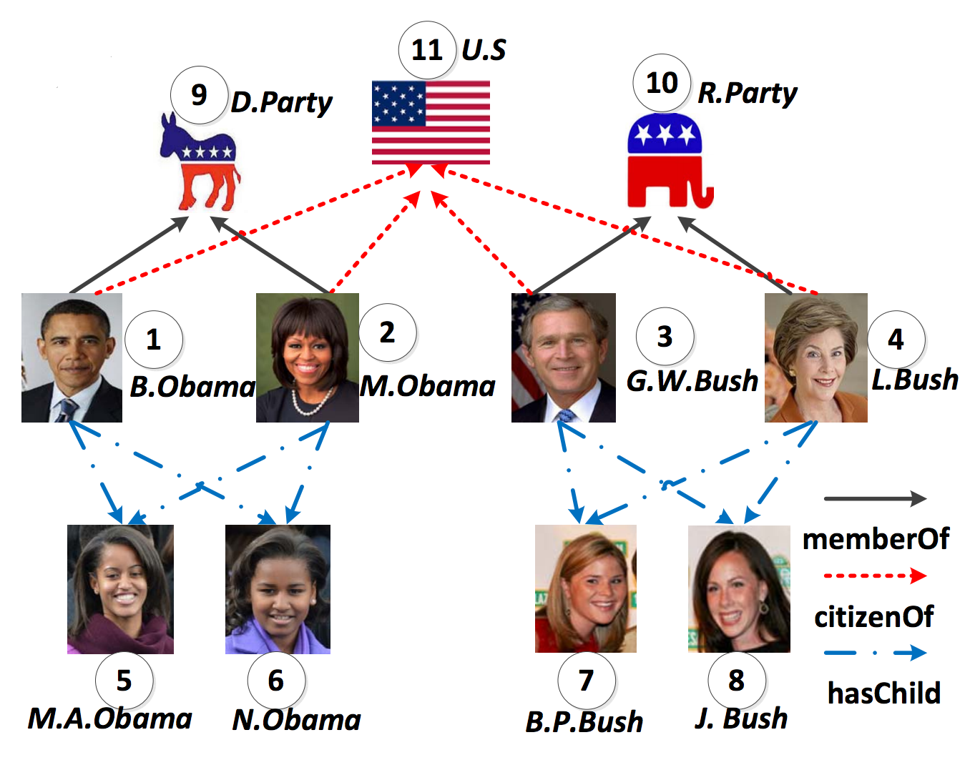
Part I: Domain Aware Task Model (3 steps)
Step 2: Hierarchical domains in knowledge bases
Step 3: For each task, we obtain the task model (a vector of distribution)
Sports
Politics
Entertainment
Did Michael Jordan win more NBA championships than Kobe Bryant?
Sports

Slide 8
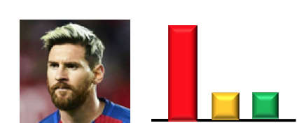

Part II:
Domain Aware Worker Model
Model each worker using a vector
Sports
Politics
Entertainment
Each element in the vector is in the range of (0,1), indicating the expertise of the worker to a specific domain.
Our ideas to initialize each worker’s model Use qualification test (like an “exam”) i.e., assign the tasks (with known truth) to the worker when the worker comes at first time

Slide 9
Part II:
Domain Aware Worker Model (cont’d)
Two rules for selecting qualification test (1) Each selected task should capture a certain domain
Good: only related to one domain (sports)
Did Michael Jordan win more NBA championships than Kobe Bryant?
Is there a name for the song that FC Barcelona is known for?
Bad: related to multiple domains (both sports & entertainment)
(2) The domain distribution of selected tasks should approximate the distribution of all tasks
KL-divergence

Slide 10


Truth Inference
1. Quality for each worker Truth for each task
Sports
Politics
Entertainment
Quality
Answer
Domain
Yes
No
Yes/No Task
Truth
Yes/No Task
Yes No

Slide 11


Truth Inference (cont’d)
2. Truth for each task Quality for each worker
Sports
Politics
Entertainment
Quality
Answer
Estimated
Truth: No
Yes
No
Quality

Slide 12
Task Assignment
Select the most suitable tasks for assignment
Sports
Politics
Entertainment
Yes/No Task
Yes No
Yes/No Task
Yes No
Yes/No Task
Yes No
Yes/No Task
Yes No
Matching Domains
Answer Uncertainty

Slide 13
Experiments
Dataset Setting (1)
Name | #Tasks | Domains | Description | Example
D_Item: ItemCompare Dataset | 360 | NBA, Food, Auto, Country | It asks workers to compare between two items | Which food contains more calories, Chocolate or Honey?
D_4D: 4 Domain Dataset | 400 | NBA, Car, Film, Mountain | It asks workers about tasks on a certain domain | Did Michael Jordan win more NBA championships than Kobe Bryant?

Slide 14
Experiments
Dataset Setting (2)
Name | #Tasks | Domains | Description | Example
D_QA: Yahoo QA Dataset | 1000 | Domains in Yahoo Answers | It asks workers tasks on Yahoo Answers | Where does chili originate from, Texas or Turkey?
D_SFV: SFV Dataset (a NLP dataset) | 328 | Domains in Yahoo Answers | It asks workers the attribute of a person, where the answers are collected from different QA systems | What is the age of Bill Gates?

Slide 15
Experiments
Worker Characteristics on Dataset D_Item
Each worker has diverse quality
Over different domains
Estimated worker quality is close to real worker quality

Slide 16
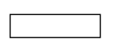


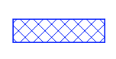


Experiments
System Comparisons
Baseline
AskIt!
iCrowd
QASCA
Greedy
DOCS
AskIt: R. Boim, O. Greenshpan, T. Milo, S. Novgorodov, N. Polyzotis, and W. C. Tan. Asking the right questions in crowd data sourcing. In ICDE, 2012.
iCrowd: J. Fan, G. Li, B. C. Ooi, K. Tan, and J. Feng. icrowd: An adaptivecrowdsourcing framework. In SIGMOD, pages 1015–1030, 2015.
QASCA: Yudian Zheng, Jiannan Wang, Guoliang Li, Reynold Cheng, Jianhua Feng. QASCA: A Quality-Aware Task Assignment System for Crowdsourcing Applications. SIGMOD 2015.

Slide 17
Summary
Consider the domain aware task model and worker model
Design solutions to accurately estimate the task model and worker model
Incorporate task model and worker model in truth inference and task assignment
Notes:
No best method!

Slide 18


Yudian Zheng, Guoliang Li, Reynold Cheng
University of Hong Kong, Tsinghua University

